Slide 1
The Earth’s Atmosphere

Slide 2
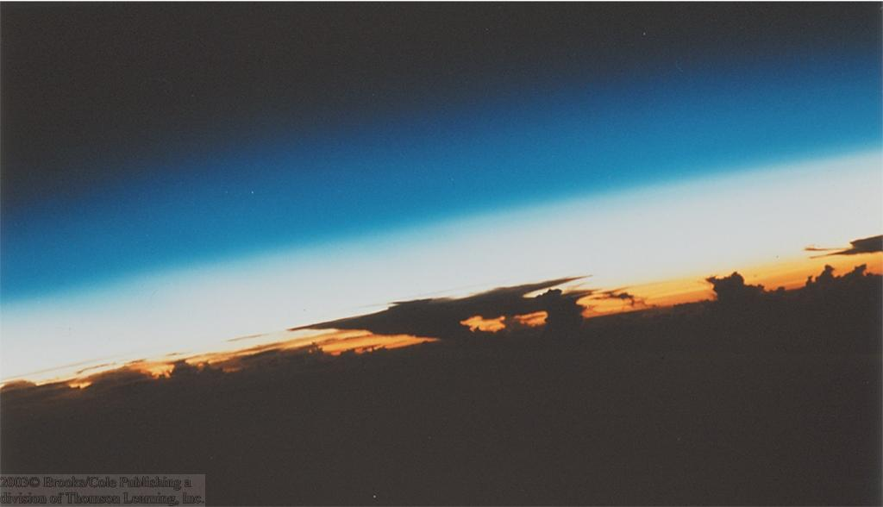
Earth's Atmosphere
Thin Gaseous envelope

Slide 3
The atmosphere is
- the vast gaseous envelope of air
- that surrounds the Earth.
Its boundaries are not easily defined.
The atmosphere contains a complex system of gases and suspended particles.
It reaches over 560 km (348 miles) from the surface of the Earth, so we are only able to see what occurs fairly close to the ground.
99% of atmospheric gases, including water vapor, extend only 30 kilometer (km) above earth's surface.
Most of our weather, however, occurs within the first 10 to 15 km.
Nearly 150 million kilometers separate the sun and earth, yet solar radiation drives earth's weather.

Slide 4
Composition of Atmosphere
Nitrogen - 78%
Oxygen - 21%
Water Vapor – 0 to 4%
Carbon Dioxide - 0 .037%
Other gases make up the rest
Lapse Rate
The rate at which air temperature decreases with height.
The standard (average) lapse rate in the lower atmosphere is about 6.5°C per 1 km or 3.6°F per 1000 ft.

Slide 5
Five distinct layers have been identified using
thermal characteristics (temperature changes),
chemical composition,
movement &
density.
The Earth's atmosphere extends from ground surface to the edge of interplanetary space. There are basically 5 (five) atmospheric layers.
Troposphere
Stratosphere
Mesosphere
Thermosphere
Exosphere

Slide 6
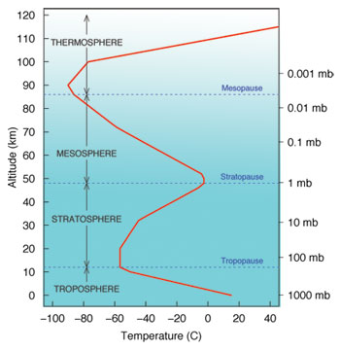
Atmospheric Layers

Slide 7
Troposphere:
The troposphere starts at the Earth's surface and extends 8 to 14.5 kilometers high (5 to 9 miles). This part of the atmosphere is the most dense. As you climb higher in this layer, the temperature drops from about 17 to -52 degrees Celsius. Almost all weather is in this region. The boundary that divides the troposphere from the stratosphere is called the "tropopause", located at an altitude of around 5 miles in the winter, to around 8 miles high in the summer, and as high as 11 or 12 miles in the tropics. The tropopause and the troposphere are known as the lower atmosphere.

Slide 8
Stratosphere:
The stratosphere starts just above the troposphere and extends to 50 kilometers (31 miles) high. Compared to the troposphere, this part of the atmosphere is dry and less dense. The temperature in this region increases gradually to -3 degrees Celsius, due to the absorbtion of ultraviolet radiation. The ozone layer, which absorbs and scatters the solar ultraviolet radiation, is in this layer. Ninety-nine percent of "air" is located in the troposphere and stratosphere. The stratopause separates the stratosphere from the next layer.
Mesosphere:
The mesosphere starts just above the stratosphere and extends to 85 kilometers (53 miles) high. In this region, the temperature again falls as low as -93 degrees Celsius as you increase in altitude. The mesopause separates the mesosphere from the thermosphere.

Slide 9
Thermosphere:
The thermosphere starts just above the mesosphere and extends to 600 kilometers (372 miles) high. The temperatures go up as you increase in altitude due to the Sun's energy. Radiation absorbing gas are present which absorb energy from solar radiation warming the air. Temperatures in this region can go as high as 1,727 degrees Celsius. Chemical reactions occur much faster here than on the surface of the Earth. This layer is known as the upper atmosphere.
Exosphere:
The exosphere starts at the top of the thermosphere and continues until it merges with interplanetary gaps, or space. In this region of the atmosphere, Hydrogen and Helium are the prime components and are only present at extremely low densities.

Slide 10
Weather & Climate
Weather is an area’s short term temperature, precipitation, wind speed, cloud cover and other physical conditions of the lower atmosphere over a short period of time.
Weather is comprised of the elements of:
a) air temperature
b) air pressure
c) humidity
d) clouds
e) precipitation
f) visibility
g) wind
Climate represents long-term (e.g. 30 yr) averages of weather. Average temperature and average precipitation are the two main factors determining climate.

Slide 11
Controls of weather and climate

Slide 12
Factors responsible for global and local climate
Solar radiation reaching the area.
Earth’s daily rotation at his own axis
Annual rotation at his orbit (around the sun)
Air circulation over the surface
Global distribution of landmasses and water
Circulation of ocean currents
Elevation of the landmasses (altitude)

Slide 13
